Slide 1

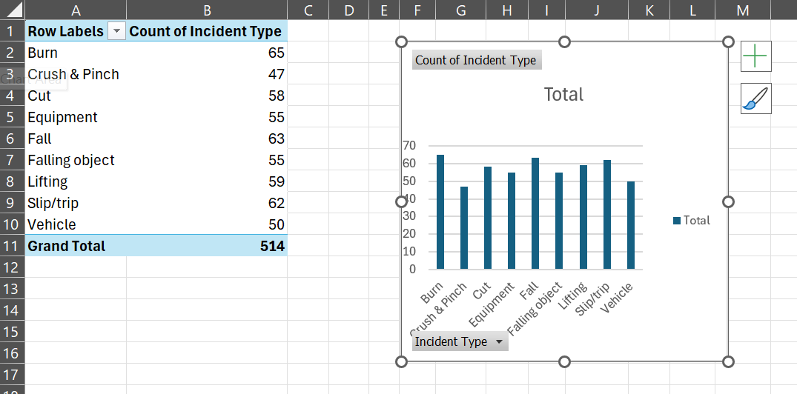
Task1: What is the total number of safety incidents recorded in the dataset?

Slide 2
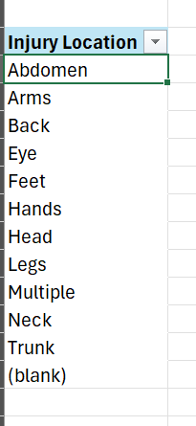
Task2. How many unique injury locations are there in the dataset?

Slide 3
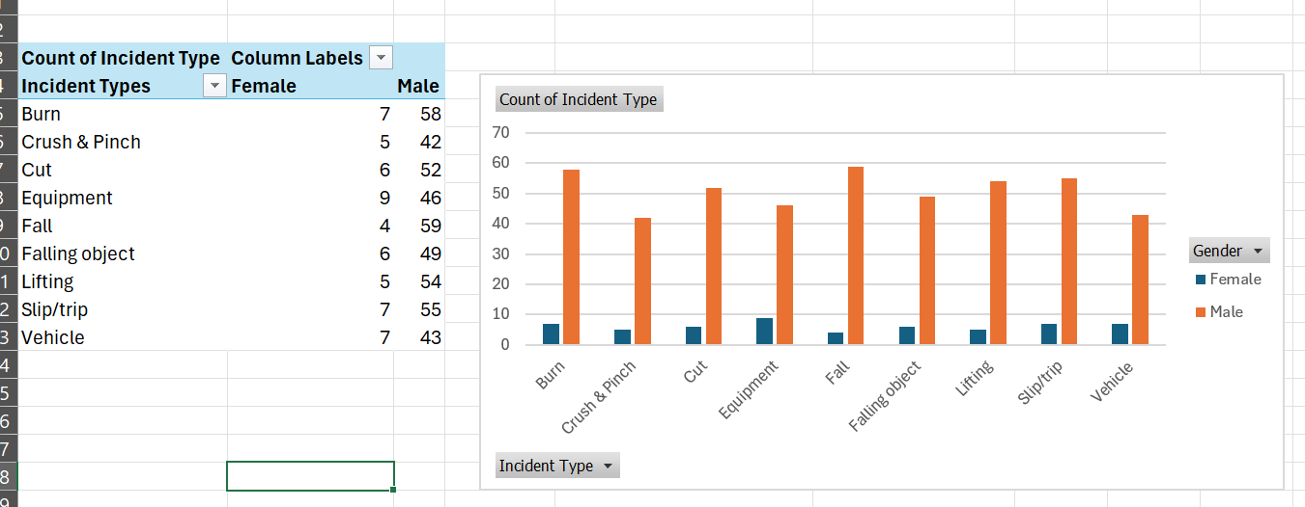
Task3. What is the distribution of gender among employees involved in safety incidents?

Slide 4
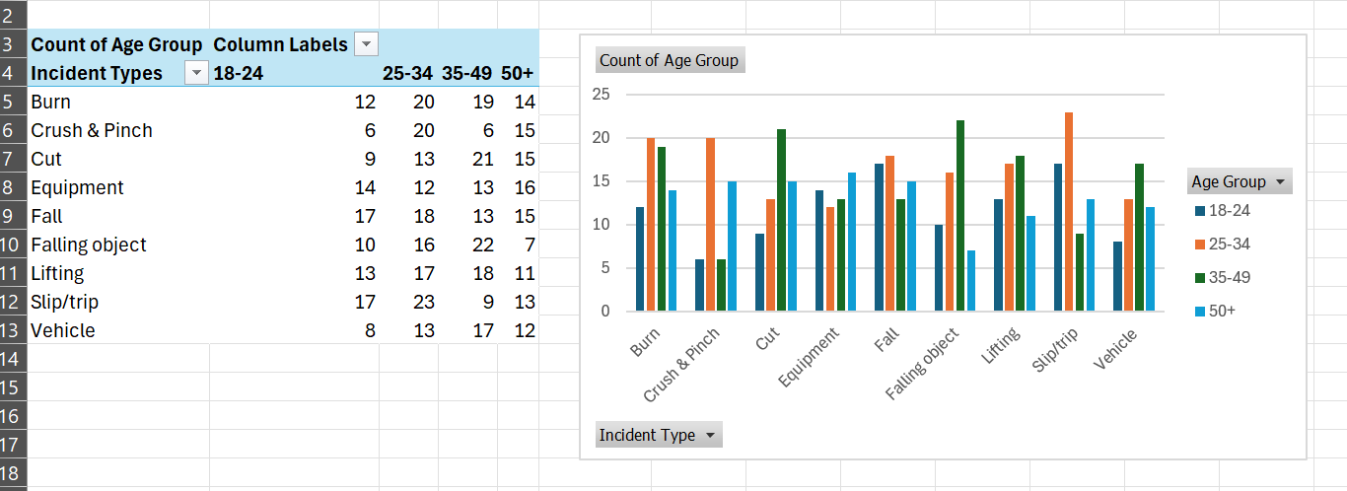
Task4. Which age group has the highest number of safety incidents?

Slide 5
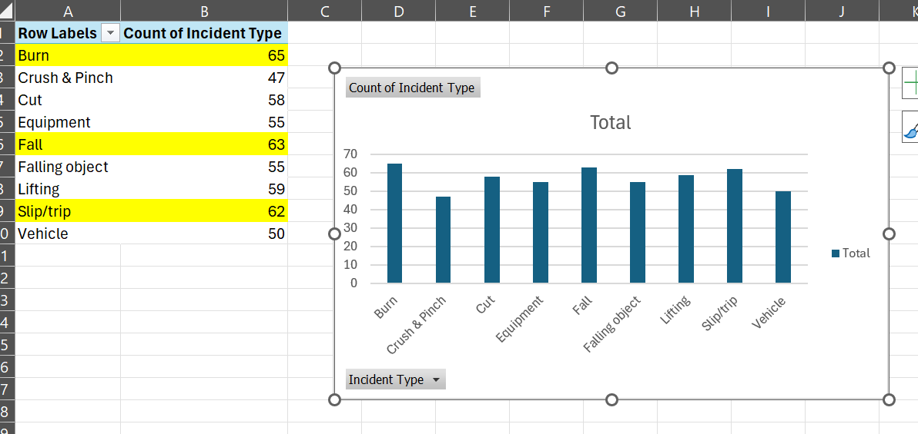
Task5. What is the most common type of safety incident?

Slide 6
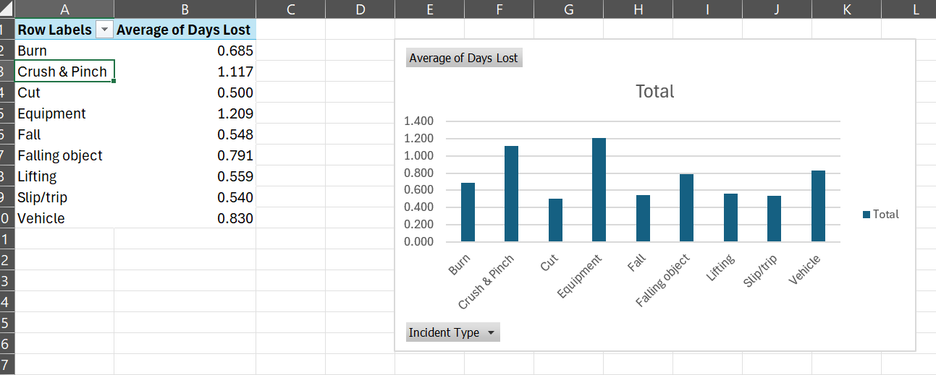
Task6. What is the average number of days lost per safety incident?

Slide 7
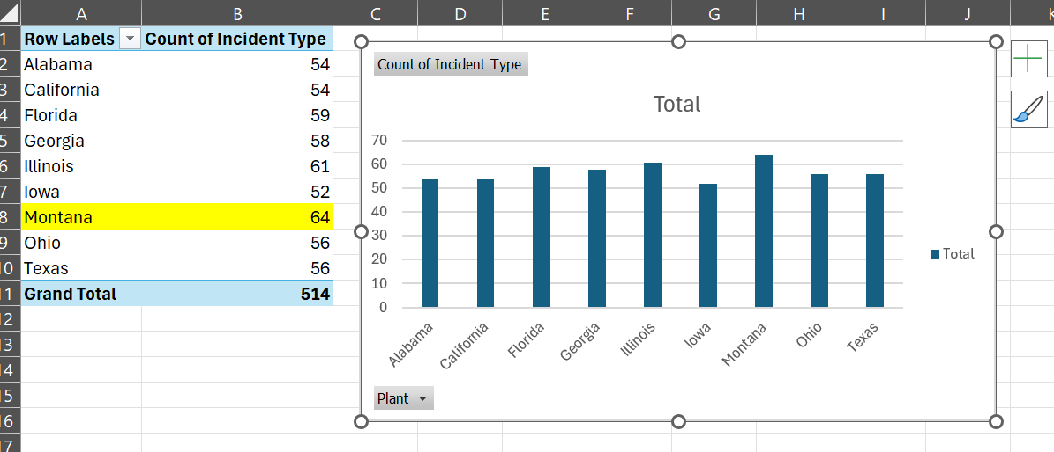
Task7. Which plant has the highest number of safety incidents?

Slide 8
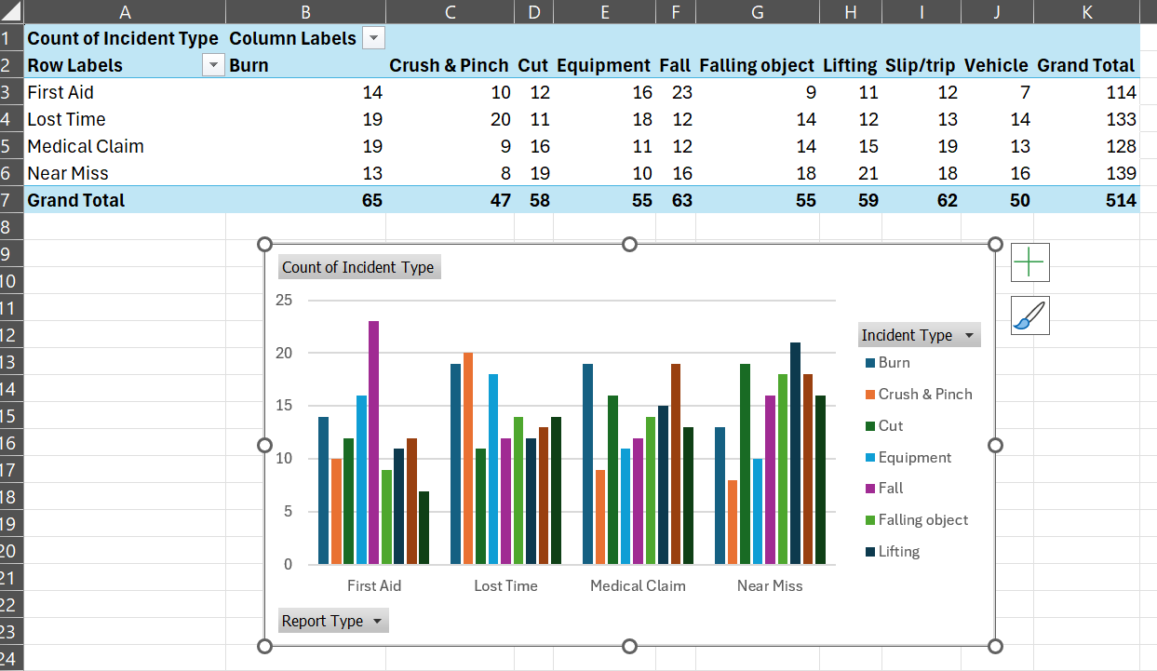
Task8. What is the distribution of report types filed for safety incidents?

Slide 9
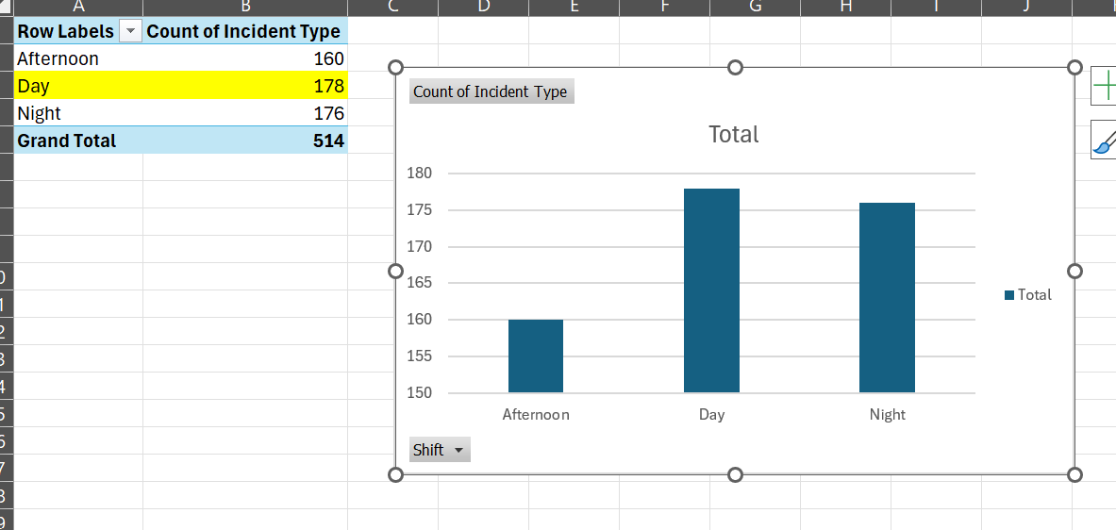
Task9. During which shift do most safety incidents occur?

Slide 10
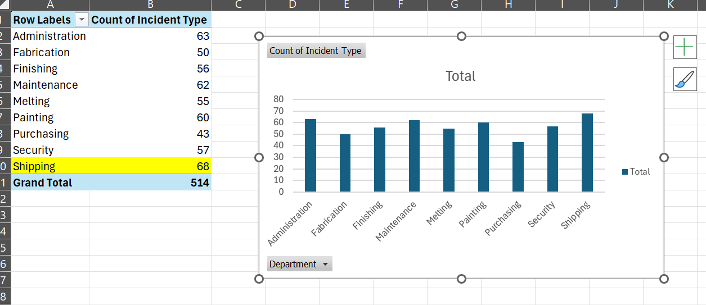
Task10. Which department has the highest number of safety incidents?

Slide 11
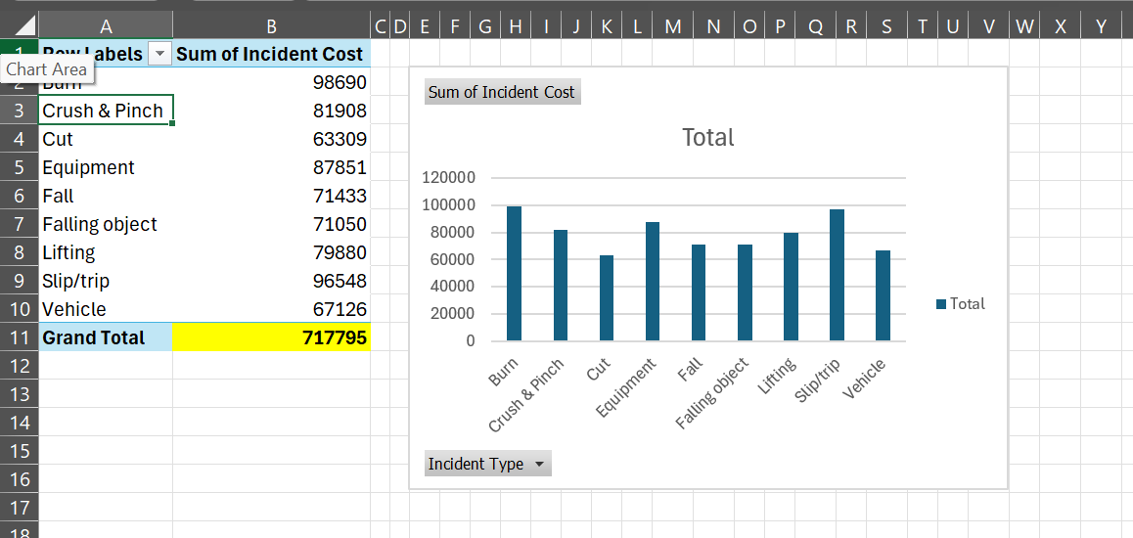
Task11. What is the total cost of safety incidents recorded in the dataset?

Slide 12
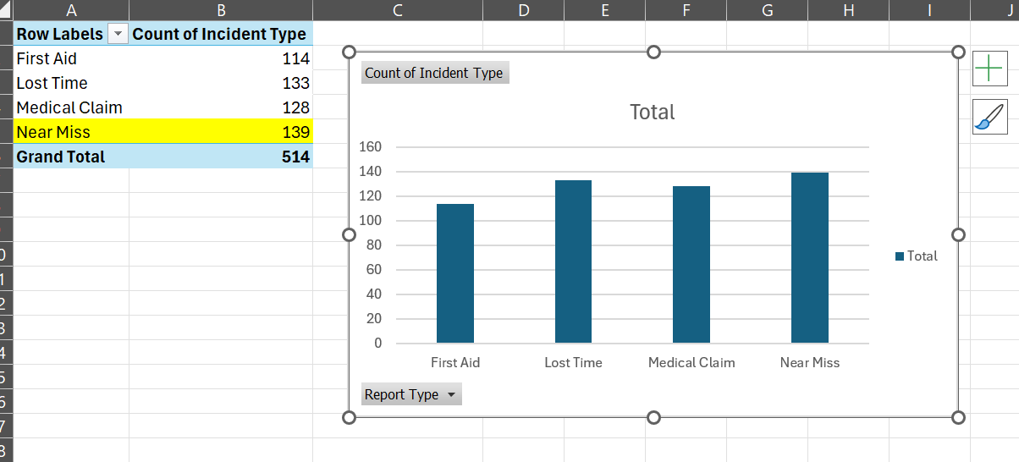
Task12. How many safety incidents were reported as "Near Miss"?

Slide 13
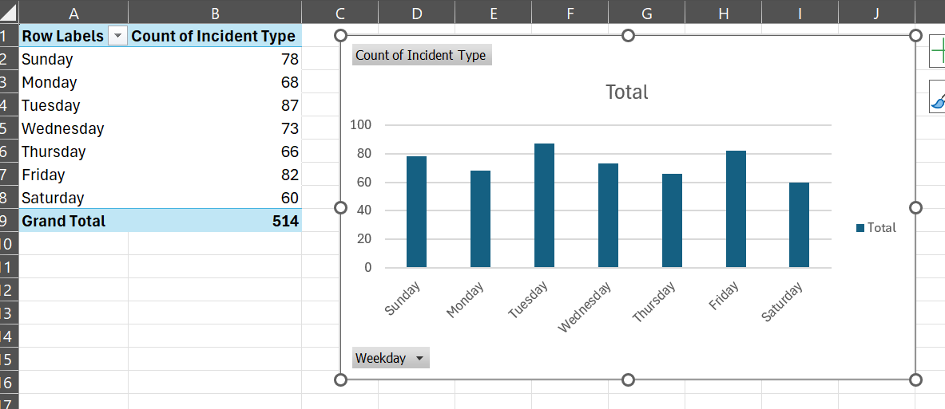
Task13. What is the distribution of safety incidents across different days of the week?

Slide 14
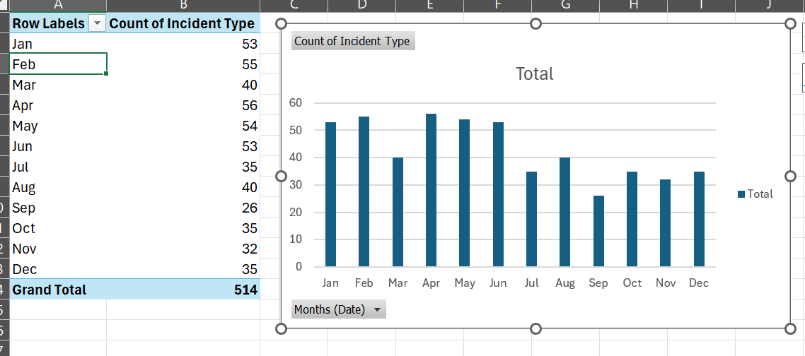
Task14. How many safety incidents occurred in each month?

Slide 15
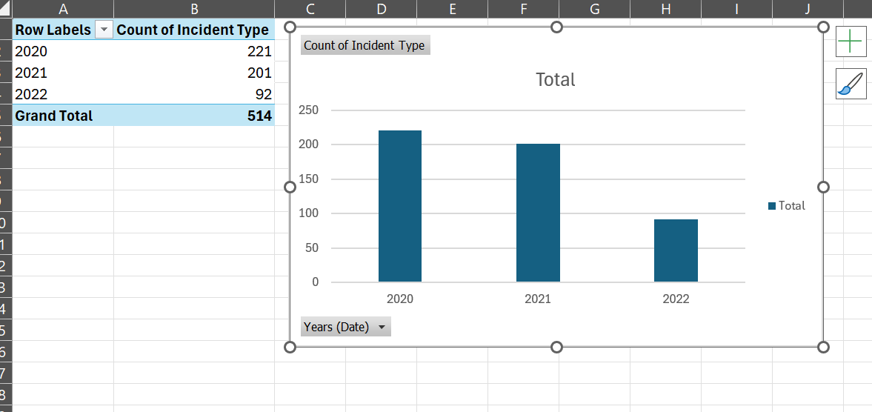
Task15. What is the trend of safety incidents over the years?

Slide 16
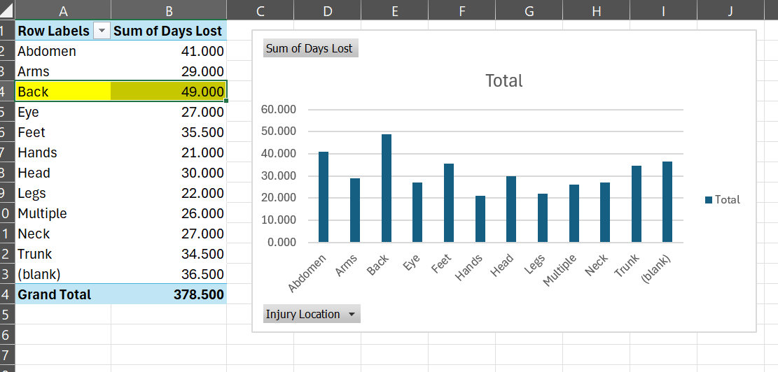
Task16. Which injury location results in the highest number of days lost on average?

Slide 17
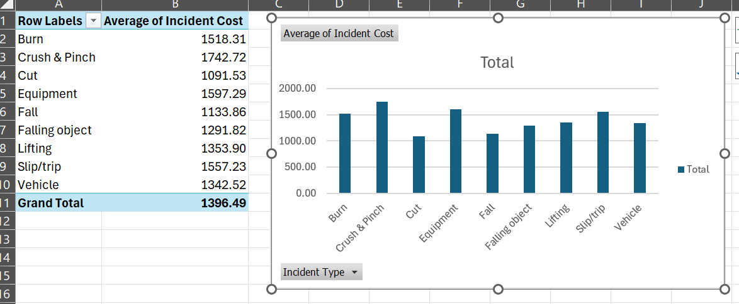
Task17. What is the average incident cost for each type of safety incident?

Slide 18
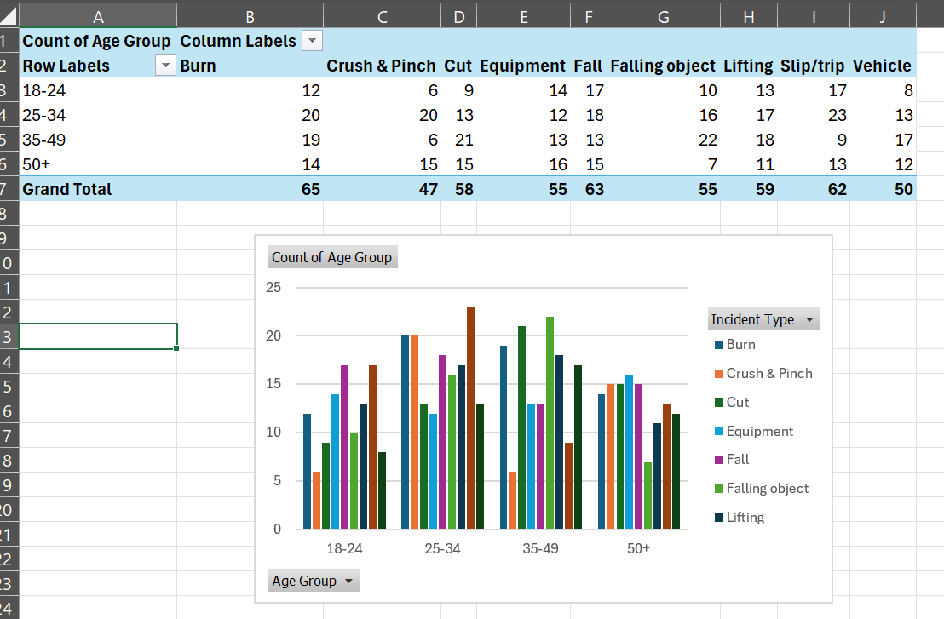
Task18. Is there any correlation between age group and incident type?

Slide 19
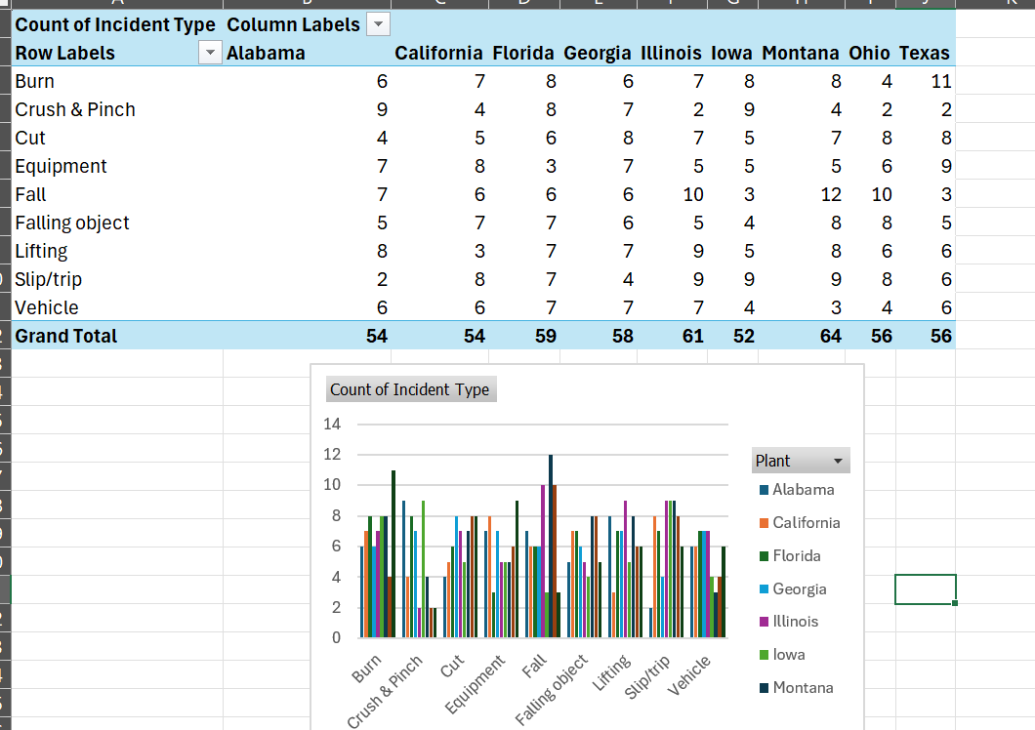
Task19. How does the distribution of safety incidents vary across different plants?

Slide 20
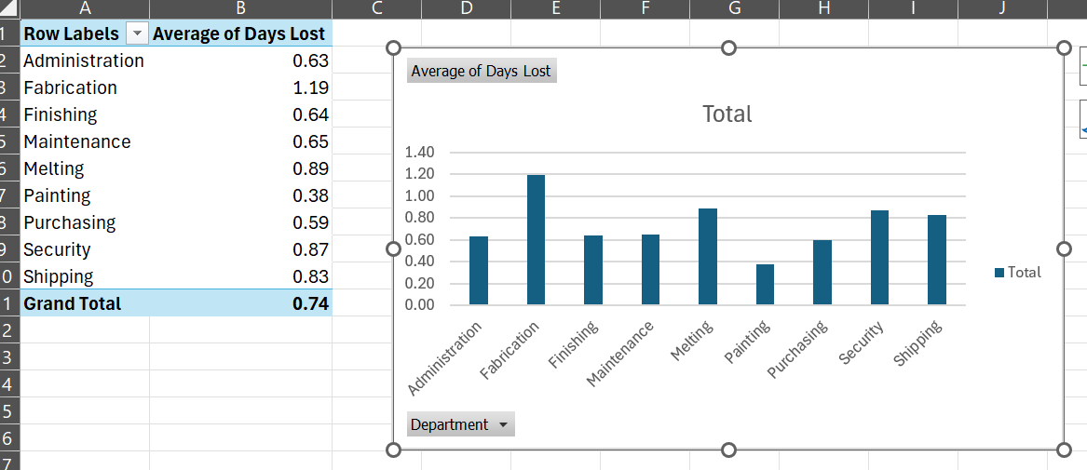
Task20. What is the average number of days lost for safety incidents in each department?

Slide 21
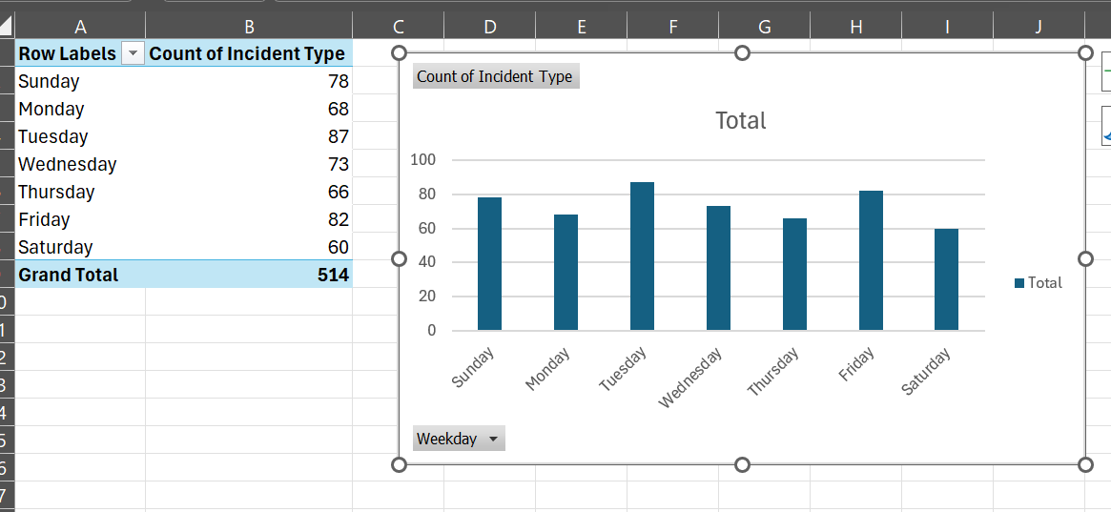
Task21. Are there any noticeable patterns in safety incidents based on the day of the week?

Slide 22
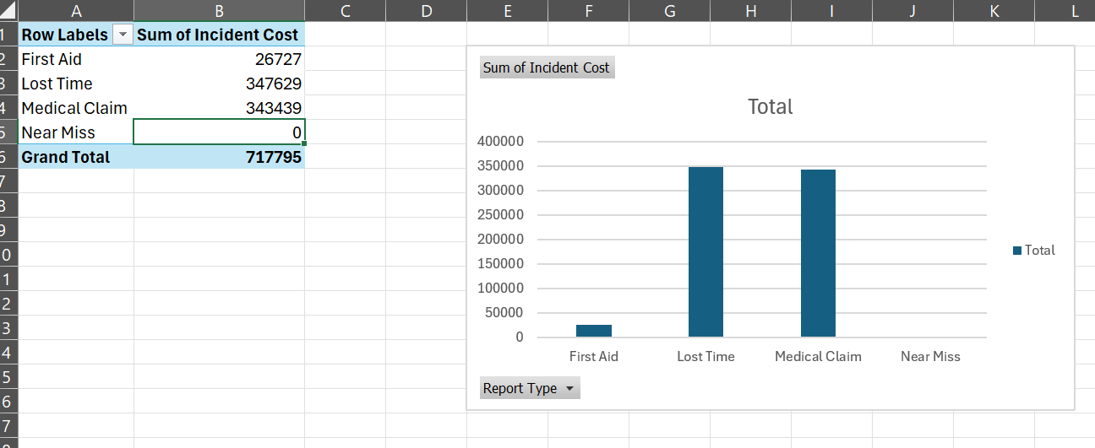
Task22. Is there a difference in incident costs between different report types?

Slide 23
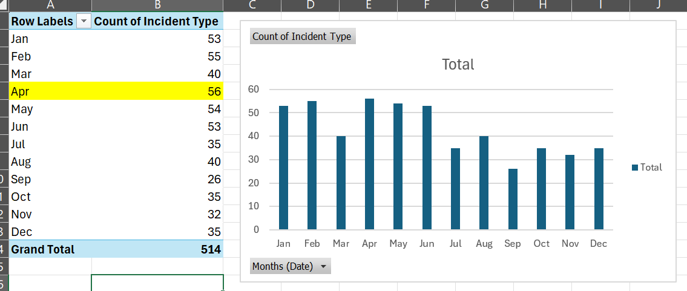
Task23. Which month has the highest number of safety incidents reported

Slide 24
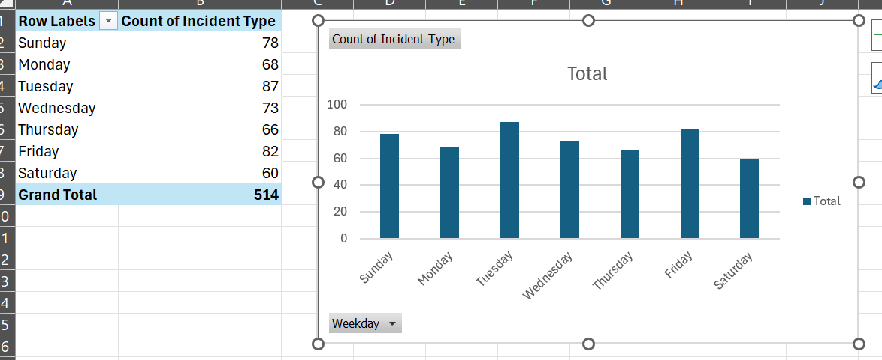
Task24. Is there any correlation between the day of the week and the number of safety incidents?

Slide 25
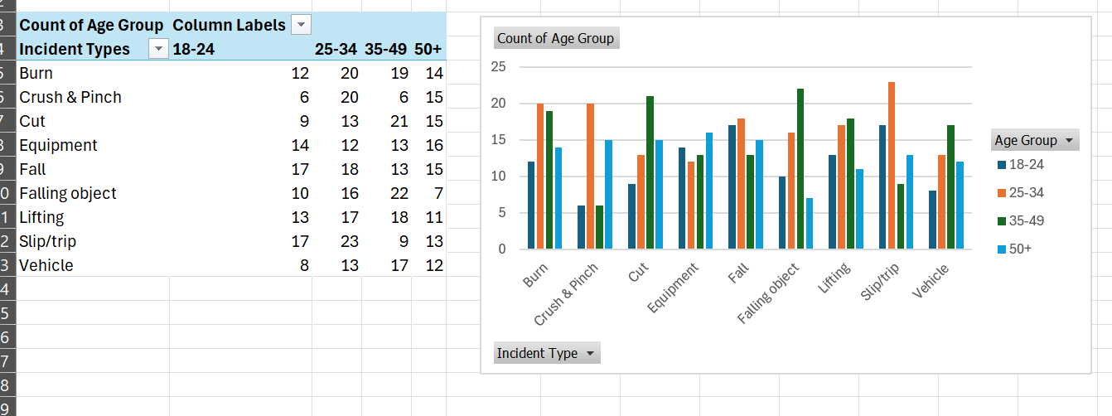
Task25. What is the average age of employees involved in safety incidents?

Slide 26
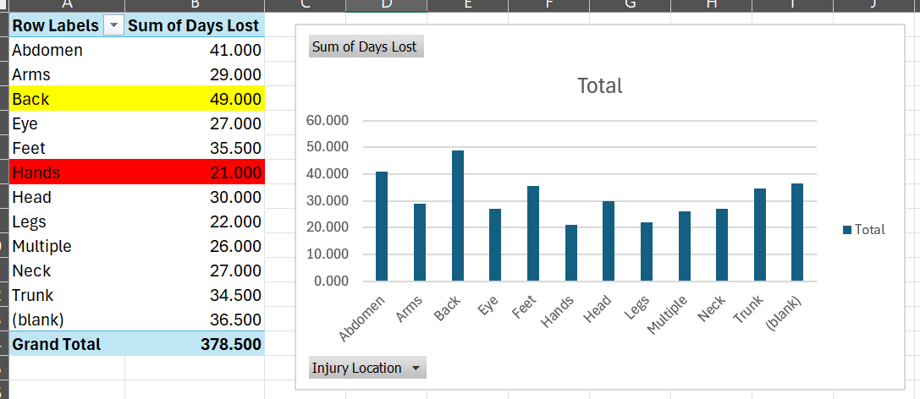
Task26. Are there any outliers in the number of days lost for safety incidents?

Slide 27
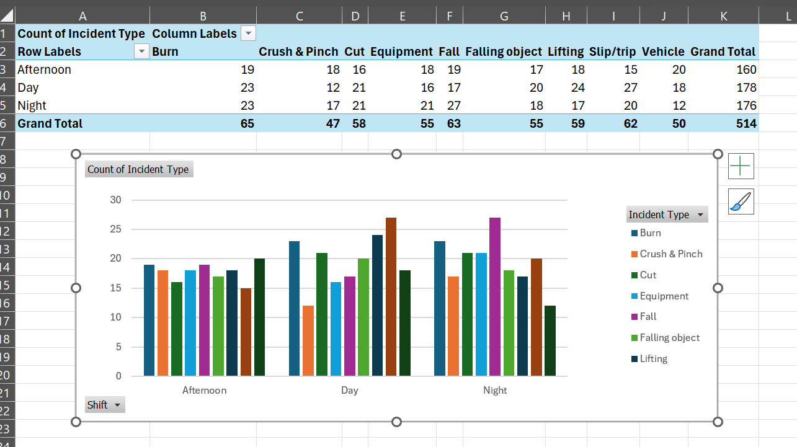
Task27. How does the distribution of safety incidents vary across different shifts?

Slide 28
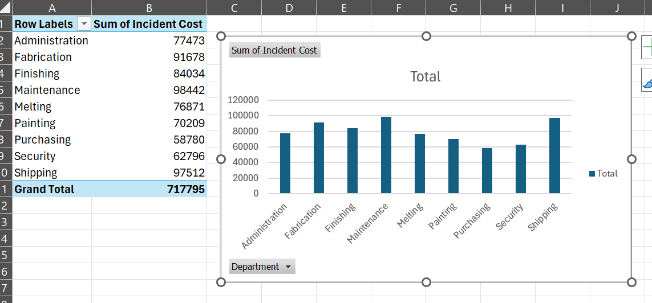
Task28. Is there a relationship between incident cost and the department where the incident occurred?

Slide 29
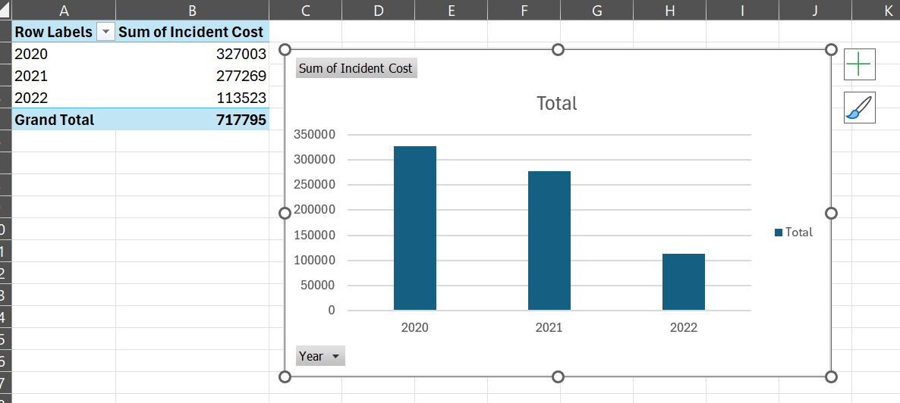
Task29. Are there any trends in incident costs over the years?

Slide 30
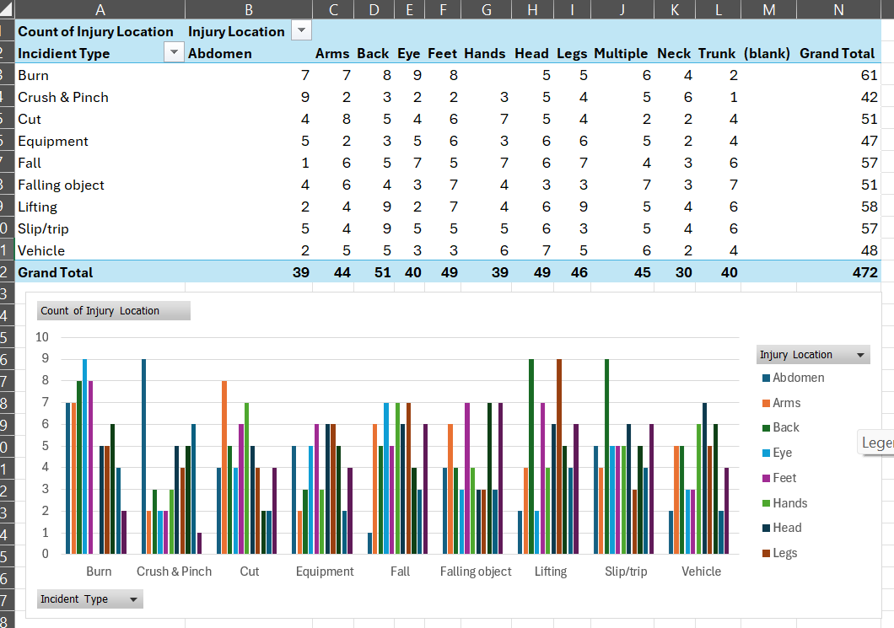
Task30. What is the most common combination of injury location and incident type

